Slide 2




Project’s overview
TealHelix: Building Resilience Through Inclusive and Personalised Food Labeling
Coordinator: KU Leuven (Belgium)
Duration
17 partners
1 Sep ‘24 – Aug 31 ‘28
11 EU countries
Topic: HORIZON-CL6-2023-COMMUNITIES-01-6
Consortium’s disciplines: Marketing, consumer behaviour, psychology, environmental sciences, communication, retail, and standard-setting

Slide 3
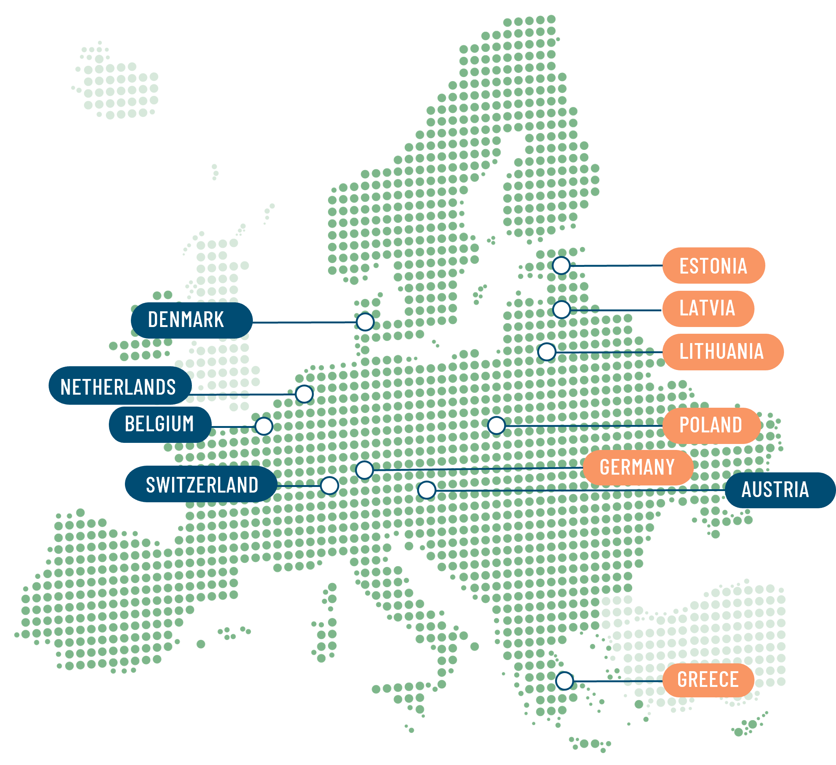

















Consortium

Slide 4






The concept – Consumers’ challenges
Low consumer trust and motivation in sustainability labels.
Lack of tailored solutions for diverse consumer needs, especially vulnerable groups.
Limited understanding of media, marketing, and retail influences on food choices.
Absence of comprehensive assessment tools for sustainability dimensions.

Slide 5

Approach
TealHelix introduces a personalised and inclusive approach to food sustainability labelling by:
Empowering Consumers: Using motivational matching for better decision-making
Developing New Standards: Aligning individual and planetary preferences for sustainability goals
Testing Labelling Methods: Traditional, digital, and smart labelling approaches & develop integrity guidelines and industry standards
Empower
Develop
Test

Slide 6

Objectives
Understand consumer needs & influences – Analyse media, socio-cultural, and marketing impacts & identify key information needs.
Obj. 1
Develop personalised labelling solutions – Create the Sustainable Food Compass to align consumer preferences with sustainability goals.
Obj. 2
Empower consumers with digital tools – Launch AI apps (LabelGuide, HowiBuy) for informed and sustainable choices.
Obj. 3
Support vulnerable groups – Design tailored interventions to address the needs of disadvantaged consumers and enhance inclusivity.
Obj. 4
Set industry standards & policy – Develop guidelines & recommendations to enhance trust & integrity of sustainable labelling.
Obj. 5

Slide 7
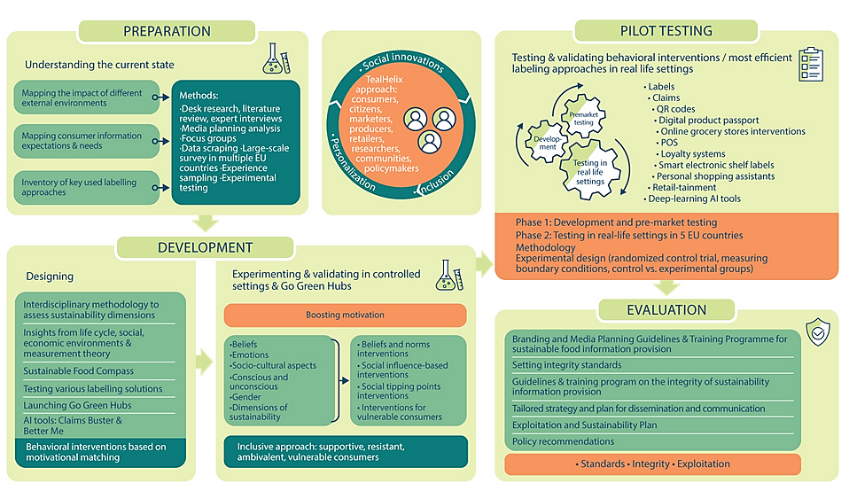

Methodology

Slide 8
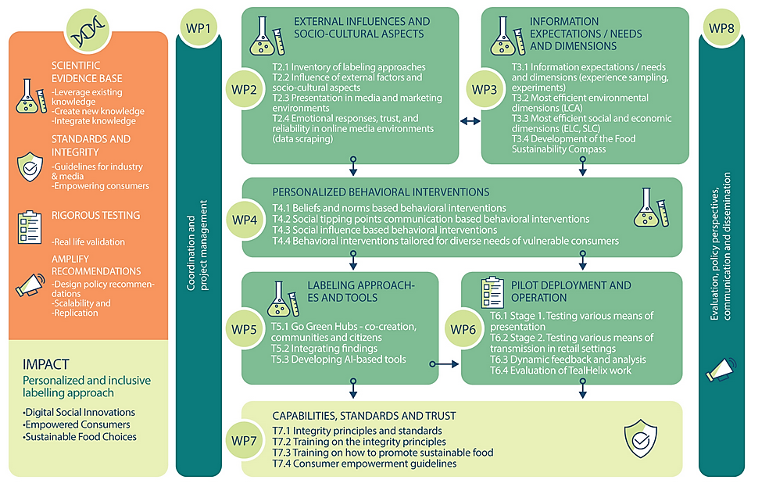
Work Plan Overview

Slide 9
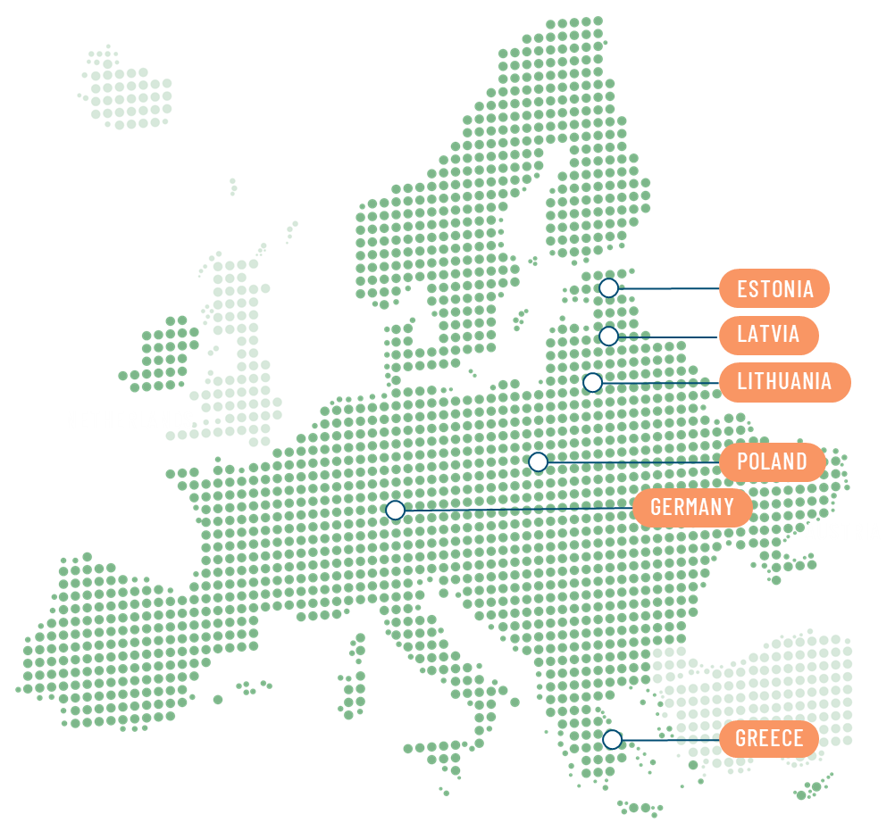
Pilots
SAR
(Poland)
Rimi Baltic
(Lithuania, Latvia, Estonia)
● Association of communication agencies
● Characteristics: experts in creative, digital campaigns, and media planning
● Developing our solutions and testing means of presentation
● One of the largest retailers in Baltics
● Traditional brick-and-mortal and digital shopping
● Testing our labelling interventions in real-life settings
● Integrating AI-based app HowiBuy in the Rimi app
GS1 (Germany)
UoM
(Greece)
● Laboratory supermarket
● Innovative platform for interactive consumer journey
● Pre-testing our interventions in an interactive shopper journey
● Online marketplace that offers consumers a range of products from small local food producers
● Testing our labelling interventions in real-life settings
● Integrating AI-based app HowiBuy in the system

Slide 10

Expected outputs
Key Methodologies
Developing strategies to support and include diverse consumer groups.
A science-based approach to assess their impact on sustainability perceptions.
Understanding conscious and unconscious sustainability expectations.
Comprehensive evaluation of environmental, social, and economic factors.
Standards and guidelines for sustainable food labeling
Defining integrity boundaries for businesses and governments to guide consumer decisions and developing a training program to promote sustainable food effectively.

Slide 11

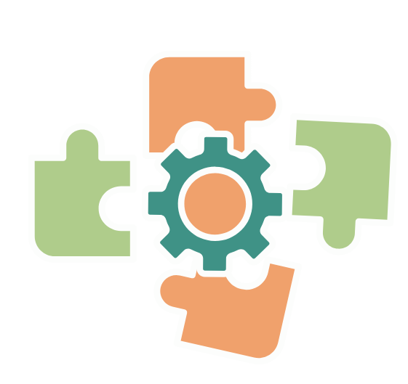


Expected outputs
Innovative Behavioural Interventions
Innovative behavioral interventions to boost the effectiveness of means of transmission (based on beliefs and norms, social influence, social tipping points).
Sustainable Food Compass
AI Apps
A psychometric tool to assess consumers’ food sustainability preferences, integrated into HowiBuy.
AI-based apps HowiBuy and LabelGuide, with HowiBuy integrating the Sustainable Food Compass to assess consumers' sustainability preferences.

Slide 12




Thank you for your attention!

